Slide 1
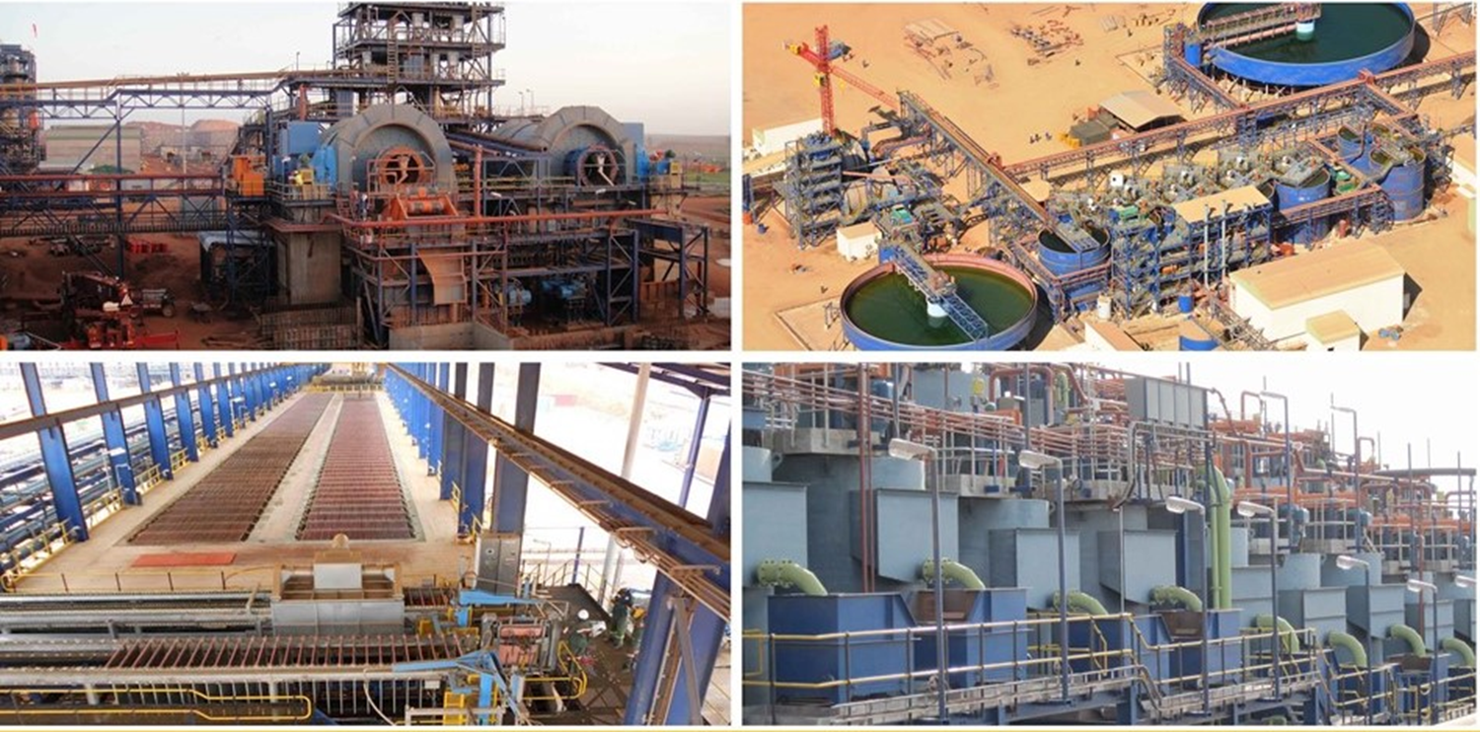



Slide 2

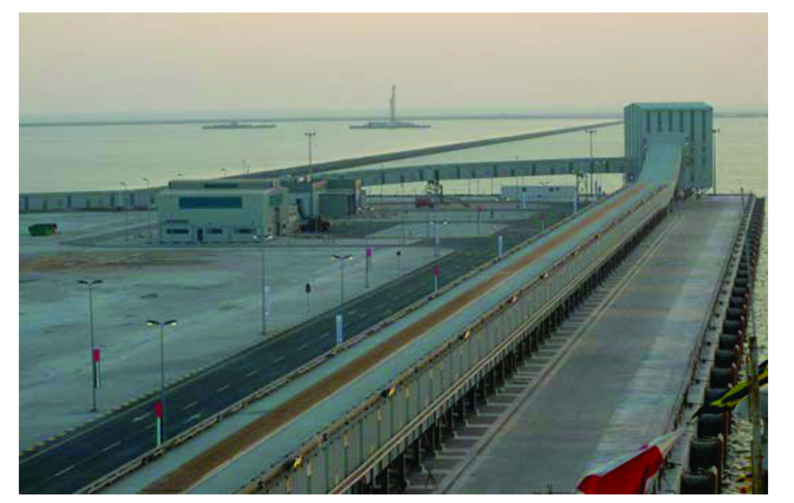
OPERATOR TRAINING
Emirates Aluminium Smelter,
ALUMINA OFFSHORE CONVEYORS

Slide 3
OPERATOR TRAINING
1. INTRODUCTION 5
2. SAFETY AROUND BELT CONVEYORS 6
2.1. Safety Requirements for Maintenance 6
2.2. Stored Energy 7
2.3. Lock out Systems 8
2.4. Personnel Training in Safe Working and Operating Procedures 8
2.5. Safe Operating Procedures 9
2.6. Basic Check List Prior to Re-starting a Conveyor 10
3. CONVEYOR SYSTEM PROTECTION DEVICES 11
3.1. Belt Control 12
3.2. Stop/Start 13
3.3. Start Warning 13
3.4. Lock out 14
3.5. Belt Alignment 15
3.6. Belt Overload 16
3.7. Belt Slip Protection & Belt Motion Detection 17
3.8. Take-up Over-travel 18
3.9. Transfer Chute Plug or Blocked Chute 19

Slide 4
OPERATOR TRAINING
3.10. Pull-cord Stations 20
3.11. Belt Tear Detectors 21
3.12. Belt Weighers 22
3.13. Belt Sampler 22, 23
3.14. Winches 23
3.15. Dust Collectors 24
3.16. Belt Magnet 24
3.17. Air Compressors 25
3.18. Astronomical Timer 26
4. CONVEYOR STARTING AND STOPPING 27, 28
5. ELECTRICS 29, 30
6. SAFE WORK PROCEDURE 31, 32

Slide 5
1. INTRODUCTION
Belt conveyors are probably the most efficient means of transporting bulk materials. However, they are considered dangerous due to the sheer size of the installation which prevents clear and unimpeded visibility down the length of the system. Conveyors can be one of the most hazardous mine or plant equipment installations if safety regulations are not strictly followed or if the conveyors are not properly maintained.
The Mines Health and Safety Act states that the onus is on the supplier to provide the correct conveyor design taking into consideration the risk to the health and safety of operating personnel. These same conditions are further extended to cover the installation of the conveying system as a whole.
The Mines Health and Safety Act stipulates that all exposed machinery, that when in motion, may be dangerous to any person, must be securely fenced off or adequately guarded. Guards must be provided to such part of any machinery that may be a source of danger to any person.

Slide 6
2. SAFETY AROUND BELT CONVEYORS
2.1. Safety Requirements for Maintenance
On a moving conveyor belt, the belt, pulleys and idlers are all in motion, and each idler, chute skirt, belt cleaner or pulley has a potential nip point, depending on its accessibility.
The prohibition of work on moving machinery relates to tasks such as belt cleaning, house-keeping and the removal of spillage at localised points. Where build-up of carry-back material occurs on the face of pulleys and idler shells, the removal of this build-up is only permitted when the conveyor system has stopped and been safely locked out.
In instances where work needs to be carried out on the conveyor while the belt is running, such as belt training or the adjustment of material stream deflectors, it is important that this be performed by competent teams, in accordance with approved risk assessments and safe working procedures pertaining to the task being performed.
While undertaking the necessary task, it’s important for operators to be on the alert and to stop the conveyor by activating a pull cord or an emergency stop button which must be readily accessible.

Slide 7
2.2. Stored Energy
When maintenance is required on a conveyor system, it is important to remember the danger presented by residual energy stored within the system and to address this adequately.
Thus it is necessary to isolate the stored energy from the work area or to completely release all stored energy from the system, so that work can be performed in a safe environment. This can be done by applying clamps to isolate this energy from the work area or releasing the energy applied by the take-up system.
The system tensions may also be relieved by the controlled lifting of the counterweight, or the controlled pay-out of the take-up winch system. Where belt clamps are utilised, these must be securely anchored to the structure. This applies to both permanent clamps and temporary belt pulling clamps. Belt clamps must be inspected and tested before attachment to ensure that they are able to withstand the belt tensions in the localised area.

Slide 8
2.3. Lock out Systems
  When any work is carried out on the conveyor, whether to the belting, components, or to the structure, the responsible person must ensure that the system is properly locked out, following the prescribed lock out procedures.
  Where more than one team is required to work on the system concurrently, multiple lock out procedures must be applied in accordance with the regulations and the applicable risk assessment.
  It is mandatory that all operations have prescribed safe working procedures and policies which must be adhered to. It is important that operating staff be regularly reminded of the necessity to adhere to these safe working procedures.
  All new staff, whether temporary or permanent, must be formally instructed in the safe work procedures for a particular task, and records of training must be maintained.
  Regular training of the work force is a priority.
2.4. Personnel Training in Safe Working
and Operating Procedures

Slide 9
2.5. Safe Operating Procedures
  Ensure that all personnel are equipped with the correct Personal Protection Equipment (PPE) relevant to the task and work area. Using PPE should be strictly monitored by the appropriate safety officer.
  Ensure that all STOP/START and emergency controls are clearly marked and that maintenance staff are familiar with the location of these safety systems.
  Keep the area around the belt clean and tidy and apply good housekeeping practices to minimize potential hazards.
  Lock out, isolate and tag all areas before working on any part of the conveyor.
  Do not climb on, over or crawl under any conveyor.
  Do not ride on any conveyor unless the conveyor is approved and licensed for man-riding purposes.
  The only action that can be undertaken with the belt in motion is tracking of the belt.
  Ensure that pre-start alarm is working correctly and if not, isolate the conveyor and request that it be repaired.

Slide 10
2.6. Basic Check List Prior to Re-starting a Conveyor
  Ensure that:
  Nobody is working on the belt;
  Guards have been re-fitted and that all the safety interlocks are operational;
  The area is clean and clear of equipment and /or debris or spillages;
  All the fire fighting and fire suppression devices and equipment are in place and operational;
  All clamps are removed or released;
  The take-up system is operational.

Slide 11
3. CONVEYOR SYSTEM PROTECTION DEVICES
  The belt conveyor are provided with various devices and systems for protecting the system. These devices are used as run-permissive input commands to the general belt control system. The devices must be seen as safety-critical items and for that reason, deserve a high degree of attention and maintenance. The safety of personnel and the integrity of the conveyor system are largely dependent on the correct specification, installation and operation of these devices. (Refer: 503406-PM3604-I18-0001_03 PLC Functional Description, Item 1.2.2.3)

Slide 12
3.1. Belt Control
  Belt control normally consists of the net sum of the belt permissive, the operator start/stop stations, the start warning system, interlock sequencing of individual conveyors and other process controls.
  Belt control initiates a run command to the drive controller. Sometimes the belt control issues a running reference speed to the drive controller. For stopping, the belt control simply removes the positive run signal to the drive controller or initiates a ramped stop command.
  Belt control can be initiated from the SCADA or locally situated HMI’s in each transfer station.
  Refer: 503406-PM3604-I18-0001_03 PLC Functional Description, Item 5.1.3.

Slide 13
3.2. Stop/Start
  A belt conveyor system is provided with one or more control emergency stop stations. All conveyors are started and stopped from a central control room or locally situated HMI. A stop station is a control device and must not be considered a lock out of the conveyor power source.
  All conveyors are equipped with an audible and visual system that provides a pre-start warning along the entire length of the conveyor. These include horns, sirens, flashing lights or strobes, or a combination of two or more warning signals. The start warnings are activated for a minimum period of 10 seconds after a start is requested, but before initiating motion of the conveyor.
3.3. Start Warning

Slide 14
3.4. Lock out
  Lock out of a belt conveyor is the physical lock out of all motive power sources to the conveyor so that people may access the conveyor equipment for service, inspection, clean up or maintenance. Lock out implies security supervision of the lock out elements and involves all sources of power including electrical, hydraulic, pneumatic and stored energy.
  Each drive and conveyor system requires an assessment of lock out requirements which includes any equipment or apparatus that is compliant with owner practices and policies, manufacturer’s recommendations, and regulatory requirements.
  The lock out system is interfaced with the belt control system.
  A permit system is necessary to monitor the maintenance crew and record exactly what work is carried out. After the system/conveyor is locked out, the system must be tested by attempting to start it to confirm the lock out.

Slide 15
3.5. Belt Alignment
  It is important that the belt stays aligned with the drive pulleys and the carrying and return idlers. Belt alignment sensors are typically positioned along the edges of the conveyor fabric. They are usually located at the discharge and at the loading areas of the conveyor, but can be distributed along the conveyor at intervals, depending on the conveyor route and the requirement.
  Belt alignment switches are often located on the unsupported section of belting in a horizontal take-up system in order to minimise the damage that misalignment can do in this area. Switches can consist of roller switches, limit switches, proximity switches or infra-red switches.
  When the edge of the belt trips the alignment switch for a timed period, power to the conveyor is interrupted and the system halts immediately.
  Refer: CT Systems Belt Alignment - 1200 BL ASSEMBLY VIEW or 1400 BL ASSEMBLY VIEW

Slide 16
3.6. Belt Overload
  The belt conveyor system is electrically protected from overload via the overload of the electric drive motors.
  Of course, trained operators can bridge, for example, any control and continuous spillage occurrences, despite any other protective measures that are in place. There is often evidence of such bridging or over-riding control of controls found during routine inspections.

Slide 17

  Belt slip is the loss in transmission of tension from the drive pulley(s) to the belt cover and can destroy a belt or drive pulley, causing a fire hazard. With the modern high-friction ceramic lagging of drive pulleys, the lagging itself may be destroyed depending on its type, or the belt cover completely stripped in localised areas.
  Belt motion detection includes a belt speed sensor that compares the measured belt speed with the belt signature or specified design speed. Large conveyors with long ramp times require comparative slip detection during ramping similar to the slip protection applied to variable speed conveyors.
  For constant speed belts this normally consists of a slip switch with a set point that trips the conveyor drive when the belt speed is below 80% of full speed. In order to prevent controller confusion, the belt slip switch is bypassed during starting and stopping and this is incorporated into the Head End Control Unit (HECU) or PLC.
  Belt slip in variable speed conveyors consists of a speed sensor that measures belt speed and compares it with the speed reference sent to the drive system. When the belt speed drops below 80% of the set speed, the drive is tripped. This type of belt slip is active during starting, running, and stopping.
  Refer: CT Systems Manual - 8. INSTALLATION MAINTENANCE AND OPERATING MANUAL CTS DESU.

Slide 18
3.8. Take-up Over-travel
  Over-travel proximity switches are placed at the far extremes of the counterweight or take-up device travel.
  In a gravity counterweight take-up, the top-over travel switch trip may suggest a jammed conveyor fabric condition.
  A bottom over-travel switch may indicate belt stretch, or a broken belt fabric flight. Excessive take-up motion during starting and stopping indicates an inadequate or malfunctioning drive control.
  Alternatively, excessive travel could indicate that one or more splices are failing or have failed.

Slide 19
3.9. Transfer Chute Plug or Blocked Chute
  A plugged chute or blocked chute device provides belt protection at the discharge end of the conveyor into a transfer chute. Blocked flow can result in damage to the moving conveyor.
  A blocked chute can also cause severe damage to the belt being fed, particularly in the case of a single large lump stuck in the feeding boot and slitting the belt.
  Plugged chute switches are used in many configurations depending on the application.
  Actuation of the plugged chute switch with time delay normally results in the tripping of the conveyor drive.
  Blocked chute sensors require careful maintenance because they are required to operate in extremely harsh conditions, often in the flow of material and in relatively inaccessible locations.
  Refer: Drexelbrook Plugged Chute Operating Instructions for Intellipoint RF RMT Series.

Slide 20
3.10. Pull-cord Stations
  Pull-cord stations are distributed stop switches with latching attachments. Pull-cord or pull-wire switches are installed on all conveyors.
  Where conveyors are able to be accessed from both sides, the pull-switches are located on both sides of the conveyor. Crossover systems have been developed to allow the use of pull-cord switches on both sides of the conveyor while utilising only one control system.
  Pull-switches are located along the conveyor at intervals not exceeding 100 metres between the individual switch units. The units are interconnected with a pull-wire.
  An operator activates the switch by pulling the pull-cord until the switch trips, interrupting power to the conveyor and usually raising a visual indicator flag to the control room and on site. The switch remains tripped until reset manually at the switch location. The belt does not restart on reset of the pull-cord for safety reasons.
  Tripping of the pull-cord is a controlled stop, and should not be considered a lock out of the conveyor power source, unless the units are specifically so designed. It is important to note that pull-wires are not substitutes for guards.

Slide 21
  Pull-wires must be installed in such a way that they are clearly visible and readily accessible from all areas that provide access to the conveyor.
  Refer: CT Systems Manual - 6. INSTALLATION MAINTENANCE AND OPERATING MANUAL CTS 348 PSW DC
  ✓ Tear detectors indicate rips or tears in the belt fabric, allowing quick action to be taken to protect the belt from further damage.
  ✓ Simple tea detectors are usually spill switches located below the centre of the belt near the point of belt loading. Note that particularly with steel cord conveyors, a central rip is often undetectable with the naked eye, due to the high closing forces of the troughed belt. For this reason, mechanical systems tend to be unreliable.
  ✓ Refer: CT Systems Manual - 7. INSTALLATION MAINTENANCE AND OPERATING MANUAL CTS 7480 CSSR
3.11. Belt Tear Detectors

Slide 22
3.12. Belt Weighers
  Belt Weigher determines the mass-flow rate of bulk material being transported on a belt. It involves the determination of the weight of material on the belt and the linear speed of the belt. These two variables are determined separately and brought together electronically to produce flow rate or total weight.
  Information from the Belt Weigher totalizer can be monitored in the control room SCADA.
  The belt sampler is used to sample material from a moving conveyor for laboratory testing.
  It is important to follow the correct standard operating procedure for the Belt End Sampler. By following all the instructions carefully, the sampler will experience little or no downtime and ultimately require less maintenance.
  Sampling cuts must occur at the correct interval for the sample to be representative and manageable.
3.13. Belt Sampler

Slide 23
  Sampling is initiated via operator control and is not automatic.
  Sampling cuts are initiated from the SCADA or locally at the Sampler Station.
  Monitoring of the Sampler Operation can be via SCADA in the control room or via an HMI situated locally at the Sampler Station.
  Refer: 503406-PM3604-I18-0002_SUB03 Sampler Station Functional Specification
  Conveyors CV-02 are fitted with winch operated horizontal take-up systems. For these conveyors to operate, the winch must induce tension into the conveyor belt which prevents the drives from slipping during starting, stopping and normal running.
3.14. Winches

Slide 24
3.15. Dust Collectors
  Dust from transferring alumina from each conveyor is collected by a Dust Collector situated at each Transfer Station.
  Compressed air for the operation of each Dust Collector is supplied by Plant Air Compressor System. (compressor or main plant reticulation).
  Each dust collector operates on a cycle and regular maintenance is required to check the dust collection bags on each unit.
  The dust collectors are started automatically on operation of each conveyor.
  Refer: 503406-PM3604-I18-0003_03 Dust Extraction Control Philosophy
  A belt magnet has been installed to remove any metallic objects that may be present on the belt.
  The magnet is energized once the conveyor starts. Any objects so captured are rejected into the capture area via an internal belt which operates throughout the conveyor operation.
  Refer: 503406-PM3604-I18-0001_03 PLC Functional Description, Item 1.2.1
3.16. Belt Magnet

Slide 25
3.17. Air Compressors
  Air compressors are used to supply air for the operation of the air knives and Dust Collector operations
  These compressors are connected via a SmartAir Master unit situated next to the compressor.
  Monitored information is fed directly from the compressor to the SmartAir Master unit, which is in turn directed to the SCADA for information display and remote operation.
  Operational data for the integral operation of the compressor is programmed into the SmartAir Master, or via the local control panel on the compressor, and is not available for manipulation via the SCADA.
  The compressor will have 4 modes of operation viz. Automatic Mode, Remote Mode, Local Mode & Failure Mode.
  Modes of operation are selectable via the SCADA in the control room.
  Refer: 503406-PM3604-I18-0004_03 Air Compressors Control Narrative 08 11 2012

Slide 26
3.18. Astronomical Timer
  The Alumina Offshore Conveyors have an astronomical timer programmed for the conveyor lighting, of which digital outputs will switch the conveyor lighting via relays in the Main Electrical lighting DB boards.
  PLC outputs will switch ON/OFF the emergency and normal conveyor lighting according to the time settings which can be set via data entry points on the SCADA.
  The day/night timer operates automatically once set but can be selectable from the SCADA.
  Refer: 503406-PM3604-I18-0001_03 PLC Functional Description, Item 5.1.10

Slide 27
4. CONVEYOR STARTING AND STOPPING
  High transient stresses during starting and stopping a conveyor can cause tremendous harm to a conveyor system, resulting in belt and structure damage and belt splice and pulley failures.
  Belt selections are normally based on the product of some factor of safety and the calculated effective tension under fully loaded continuous running conditions.
  The factor of safety is sized to ensure successful operation of the conveyor system under normal running stresses and during periods of higher belt stresses occurring during starting of the conveyor, when a force larger than the effective tension must be applied to accelerate the inertia system to full speed. This force is applied by the starting torque on the drive pulley/s.
  The magnitude of the starting torque is normally restricted to some percentage of the full load torque to limit the belt stresses.
  The rate at which the torque is applied (on a time scale) is also important as shockwaves can be excited in the belt which induce extremely high belt stresses.
  Refer to the table below for conveyor minimum starting times. Failure to adhere to these starting times will results in belt and structure damage and belt splice and pulley failures.

Slide 28
  The starting times for each conveyor is determined by the variable speed drive electronic software.
  Conveyors are designed to convey a specific load. Overloading the conveyor may result in spillage, wear, tear, motor burnout, structure damage, pulley and idler failures.

Slide 29
5. ELECTRICS
  All the power used along the off-shore conveyors is supplied from mini substations and switch rooms which are located in close proximity to the conveyor transfer towers. For safety reasons, access to these switch-rooms is restricted, to suitably qualified electrical personal.
  Operating staff must only enter these switch rooms, when under the direct supervision of the authorized electrical staff as appointed by EMAL’s Engineering Manager.
  Switching of electrical gear from the switch rooms should only be accomplished by qualified electrical personal, or under the direct supervision of suitably qualified and officially appointed electrical personal, to accomplish these activities.
  Before commencing with any work on or around moving equipment in close proximity to the off-shore conveyors. Operating staff should follow standard lock out safety procedures, electrical isolation should be at the switch room feeding a particular piece of electrical apparatus.
  Operational staff must be made aware of all the statutory electrical safety notices, particularly along the conveyor access ways.

Slide 30
  Operational staff should regularly check the luminaires and safety luminaires along the conveyor walk ways and around electrical apparatus pertaining to the operation of the off shore conveyors, for any defects. These defects should be reported to suitably qualified electrical staff , for remedial action.
  It is important for safe working conditions, to keep the access areas around all electrical equipment clean and tidy.
  All the motor starters and variable frequency drive speed controllers have been “preset” during the commissioning phases of the project, should there be a need for any changes to these settings, this must be accomplished by suitably qualified electrical technicians only.
  Along the conveyor walk ways the emergency exit ways are clearly marked with emergency luminaires, all operational and maintenance staff should be made aware of these exit luminaires and the exit ways.

Slide 31
6. SAFE WORK PROCEDURE
  Stand clear of material discharge and feed areas at all times. Material can be ejected unexpectedly from feed and discharge openings.
  Shut off and lock out controls before lubricating or performing any maintenance or adjustment.
  Never touch the belt or any rotating equipment when equipment is operating.
  Conveyor belts are designed to transport bulk material only. Do not allow personnel to ride or walk on belt.
  Keep clear of head and tail pulleys and idlers while conveyor is in operation.
  Do not attempt to align or train the troughing or return rolls while the conveyor is in operation.
  Keep clear of all moving parts during operation. If belt gets jammed, turn off and lock out the power source.
  Do not clean up spilled material while the equipment is in operation.
  Use skirt boards at any point on the conveyor where material spillage occurs.
  Remove all material from feed devices and chutes before performing maintenance inside.

Slide 32
  Oversized material may fall off the conveyor belt. Do not exceed maximum lump size requirements for the belt.
  Excessive conveyor belt tension will cause a damage on pulleys, shafts, belt and conveyor structure. Do not put extra counterweights ballast without consulting Mechanical Design Engineer.
  If an emergency situation occurs while conducting this task, or there is an equipment malfunction, engage the emergency stop and follow the lock out procedure
  REPORT ANY HAZARDOUS SITUATIONS TO YOUR SUPERVISOR

