Slide 1
MATERIAL HANDLING PRESENTATION Where common sense did not prevail

Slide 2
A request was made to take over the EPCM of an existing project in South Africa. The project by then had been running for some 18 months, however the Client was not satisfied with the work that had been done or not been done to date.
We had no real idea of how the project had been executed, but to our horror we were about to find out !!!
We were never going to make a silk purse from the pig’s ear, but we were asked to make some sort of purse. In hindsight, we should of walked away.
The Institute of Materials Handling

Slide 3
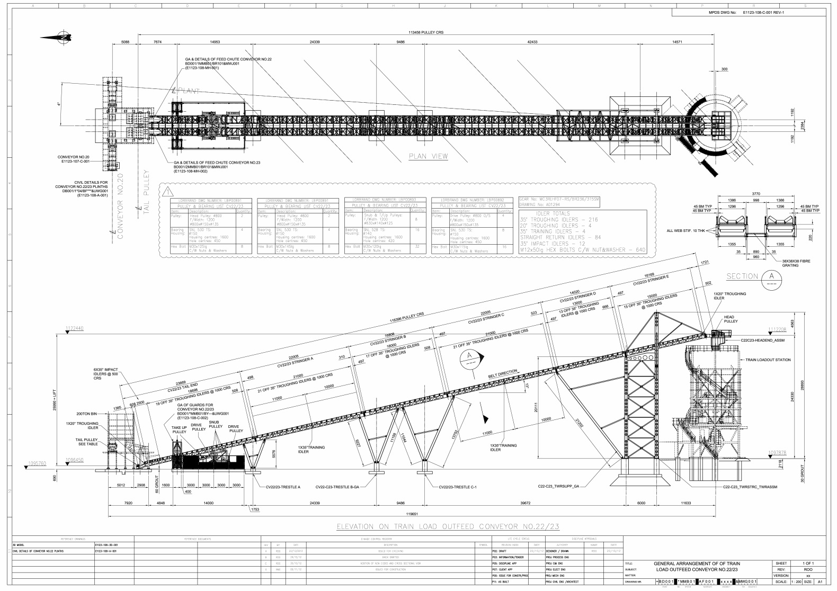
Feed conveyor to a rapid load out silo.
The Institute of Materials Handling

Slide 4
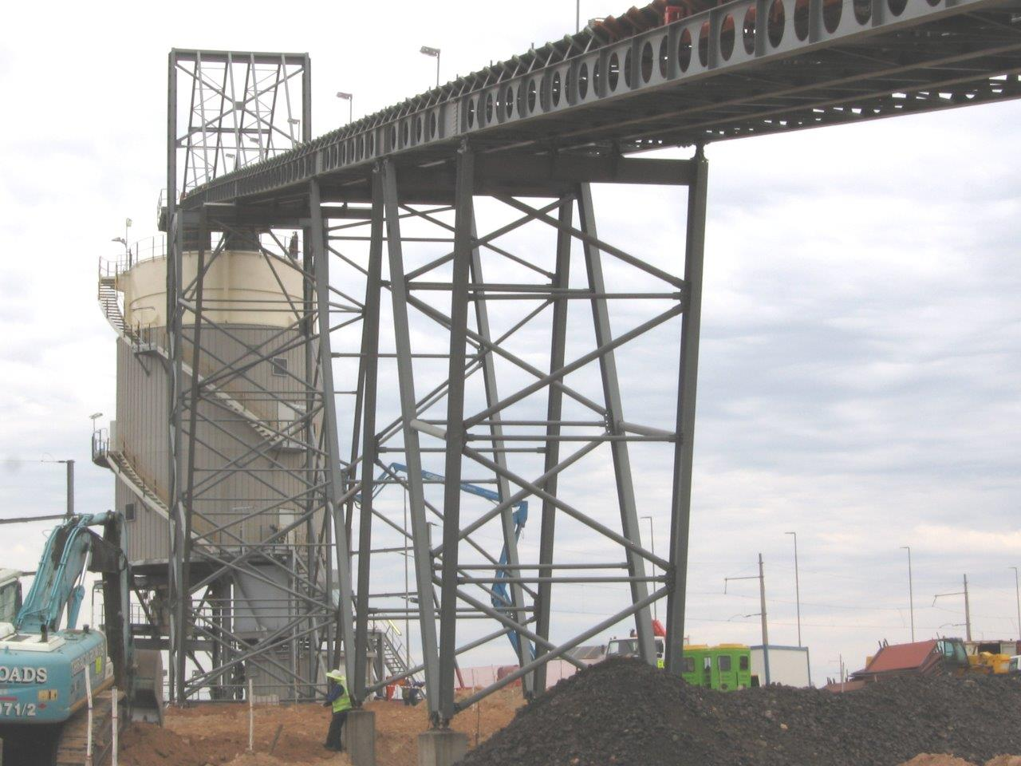
Silo feed conveyor.
The Institute of Materials Handling

Slide 5
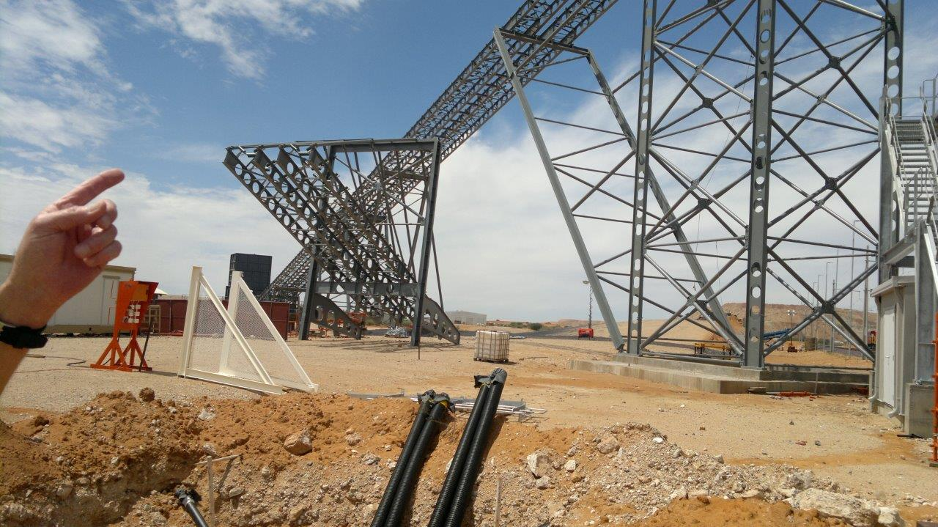
Silo feed conveyor during construction.
The Institute of Materials Handling

Slide 6
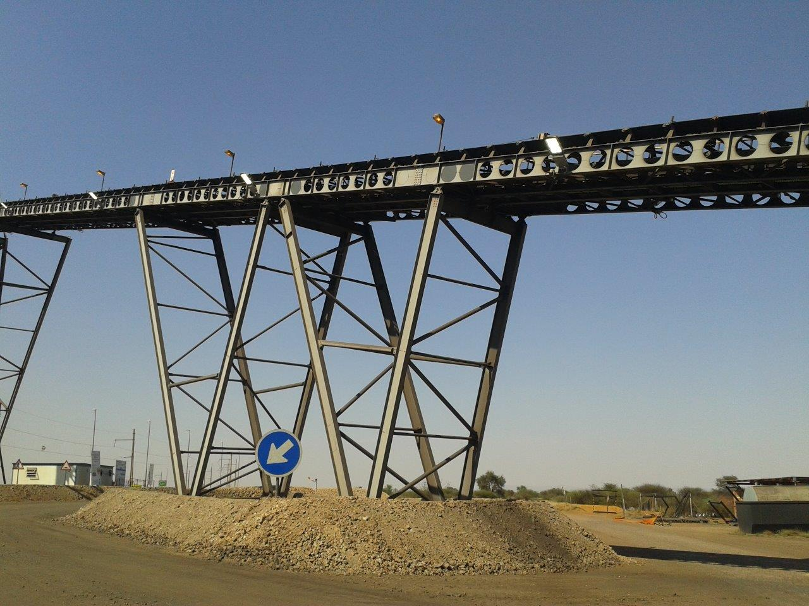
Support trestles.
The Institute of Materials Handling

Slide 7
Silo feed conveyor head end.
The Institute of Materials Handling

Slide 8
Support for cantilever head end.
The Institute of Materials Handling

Slide 9
Designer did not allow for start up belt tension or blocked head chute.
The Institute of Materials Handling

Slide 10
Head chute affixed to head platform.
The Institute of Materials Handling

Slide 11
The head chute was modified to be supported by the silo floor.
The Institute of Materials Handling

Slide 12
Safety hand railing had to be added to protect personnel.
The Institute of Materials Handling

Slide 13
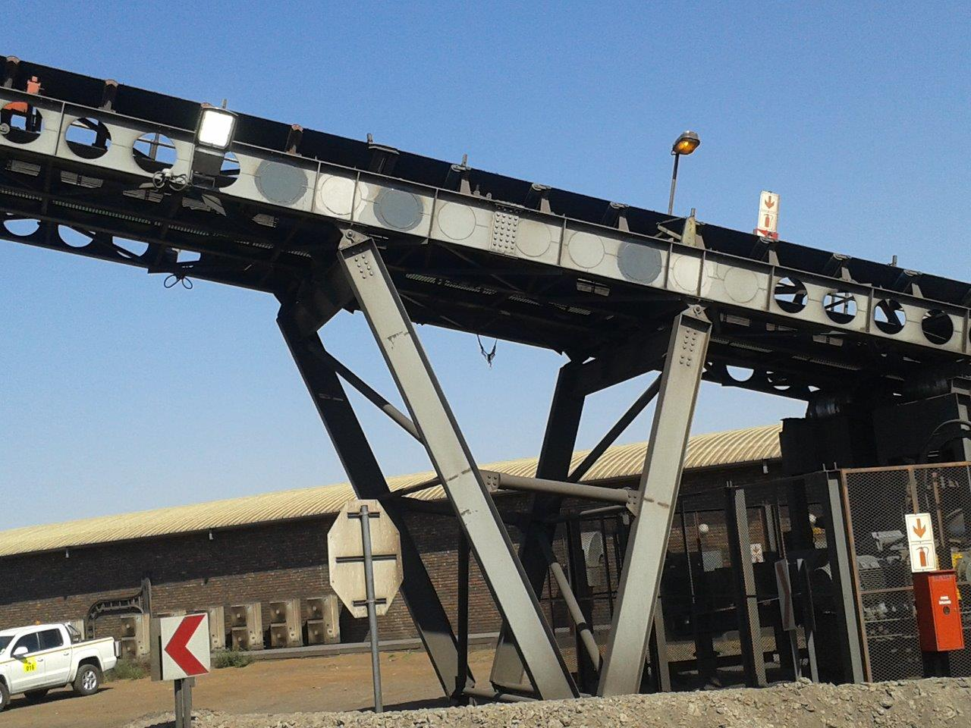
Holes had to be filled to take conveyor forces that were not allowed for e.g. flooded belt.
The Institute of Materials Handling

Slide 14
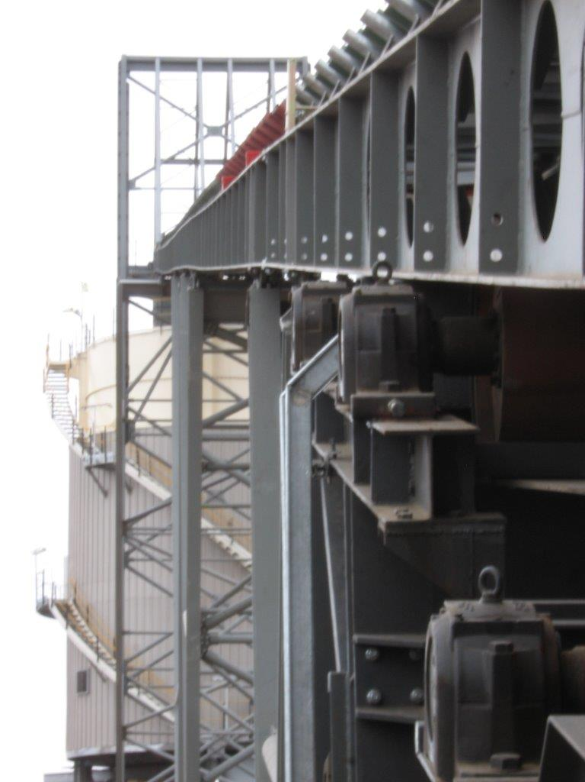
Booms are not straight.
The Institute of Materials Handling

Slide 15
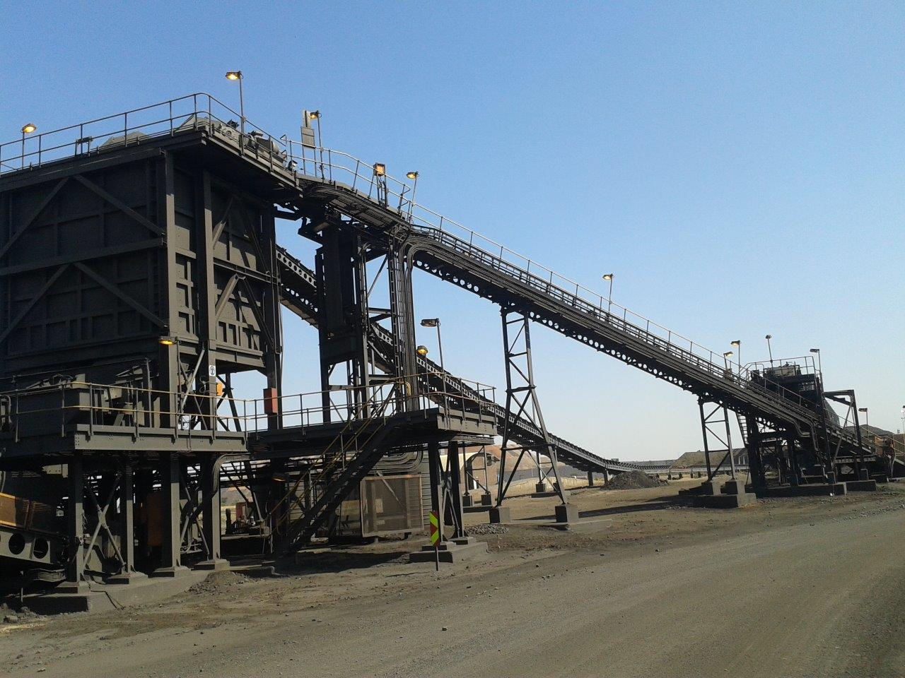
Feed conveyor to the surge bin.
The Institute of Materials Handling

Slide 16
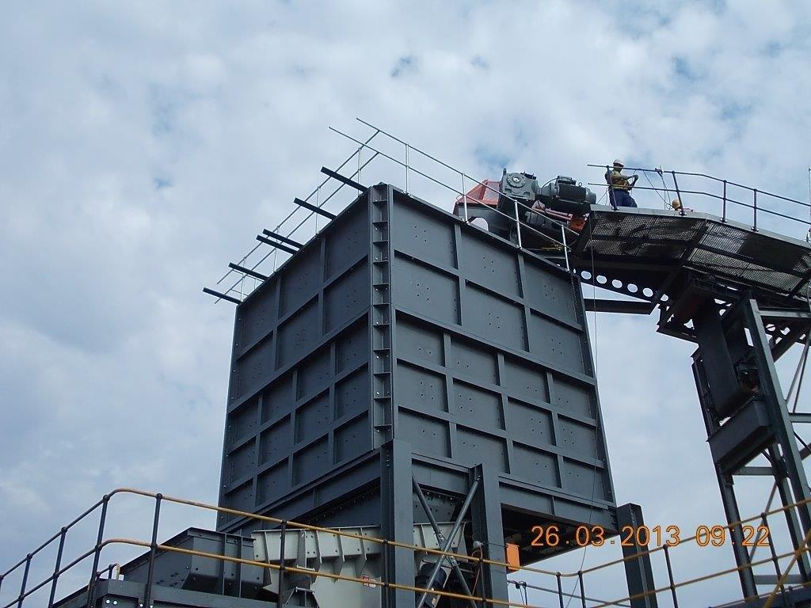
Bin had to be strengthened significantly.
The Institute of Materials Handling

Slide 17
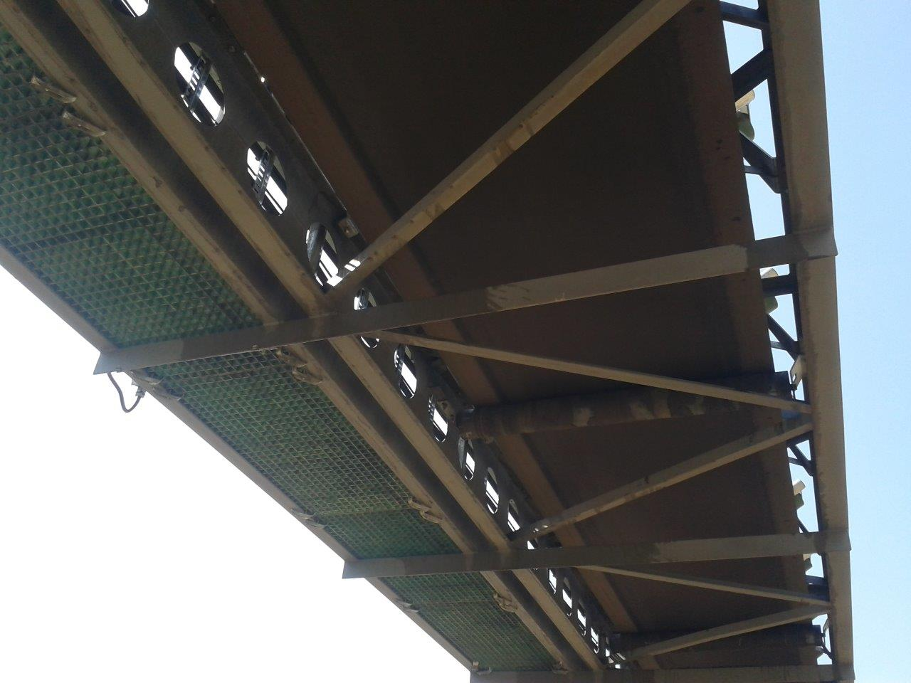
Access to return idlers can only be achieved using mobile equipment.
The Institute of Materials Handling

Slide 18
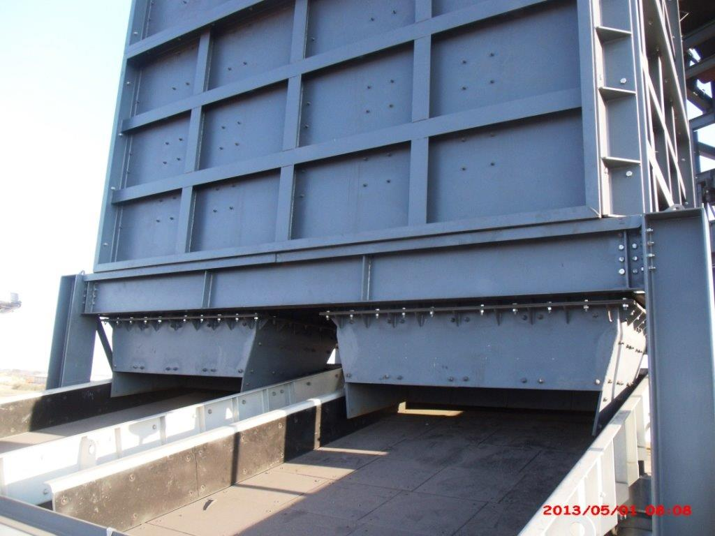
Feed chutes onto vibrating feeders. Totally inadequate.
The Institute of Materials Handling

Slide 19
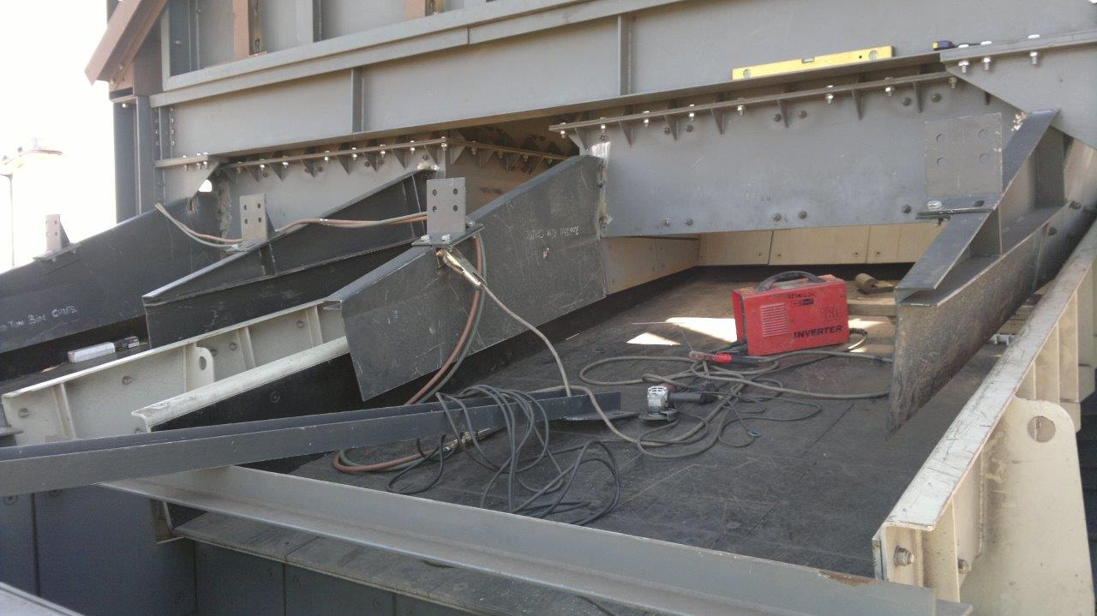
Extensive modifications were needed.
The Institute of Materials Handling

Slide 20
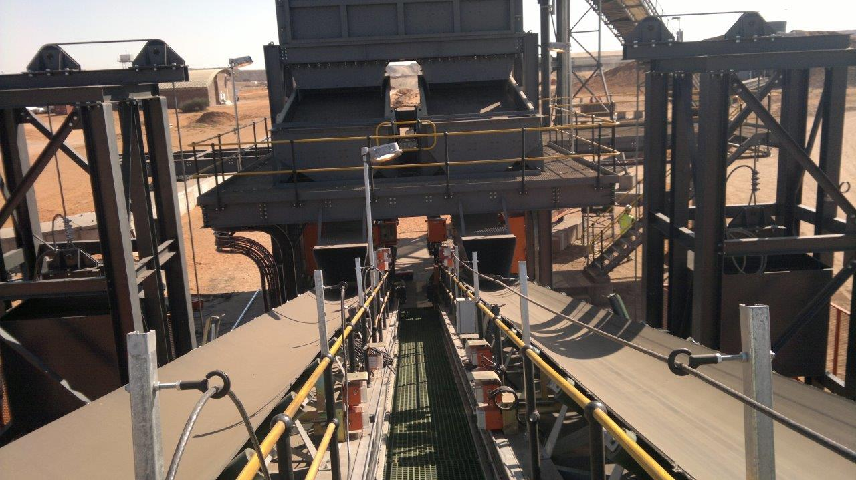
Feed chutes onto silo feed conveyor, with single walkway.
The Institute of Materials Handling

Slide 21
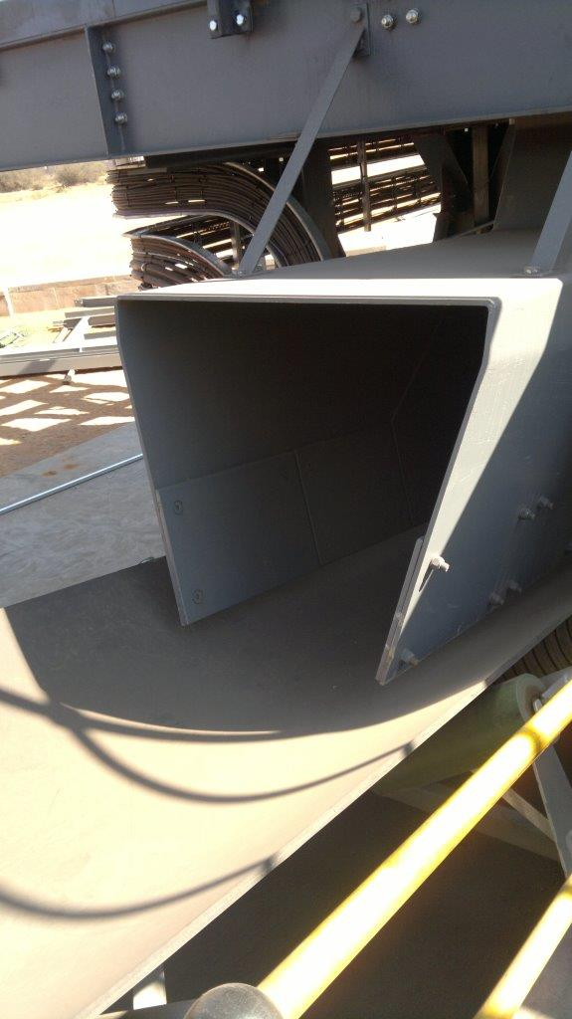
Totally incorrect chute profile.
The Institute of Materials Handling

Slide 22
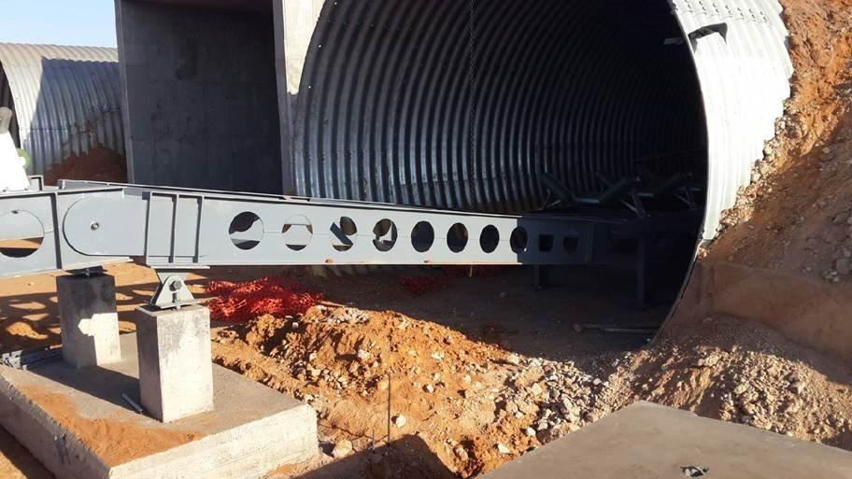
Construction misalignment.
The Institute of Materials Handling

Slide 23
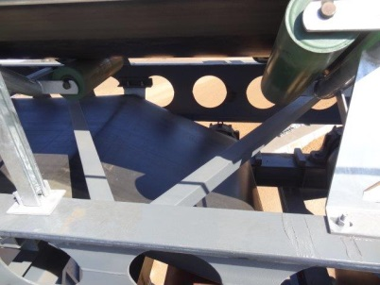
Belt severely bent around idler.
The Institute of Materials Handling

Slide 24
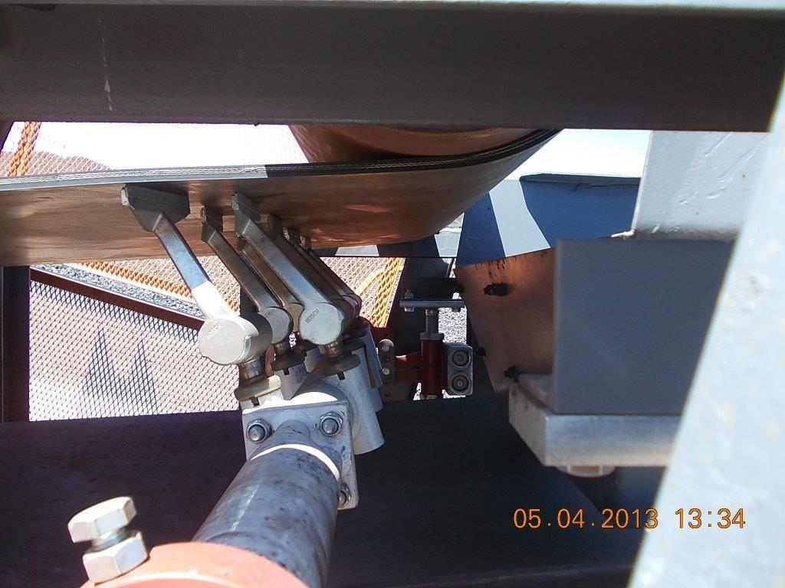
Belt scraper scrapings dropping directly onto return belt.
The Institute of Materials Handling

Slide 25
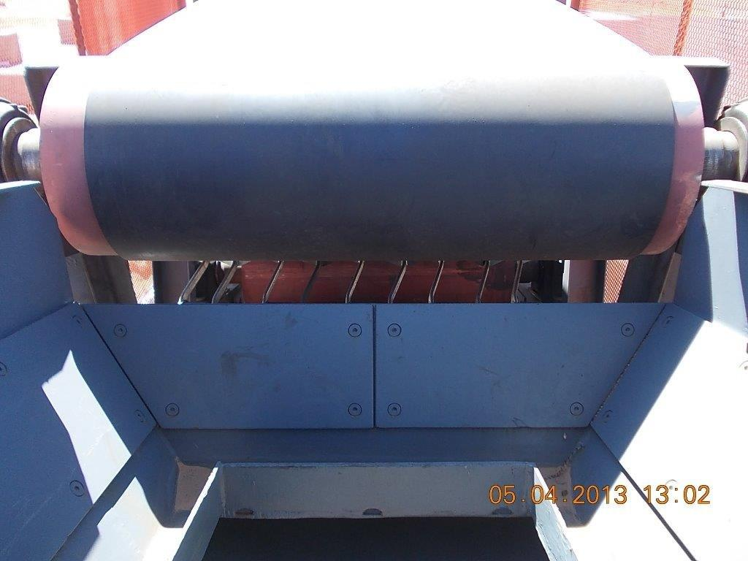
Head chute in front of scraper.
The Institute of Materials Handling

Slide 26
Drop box chute that would overflow.
The Institute of Materials Handling

Slide 27
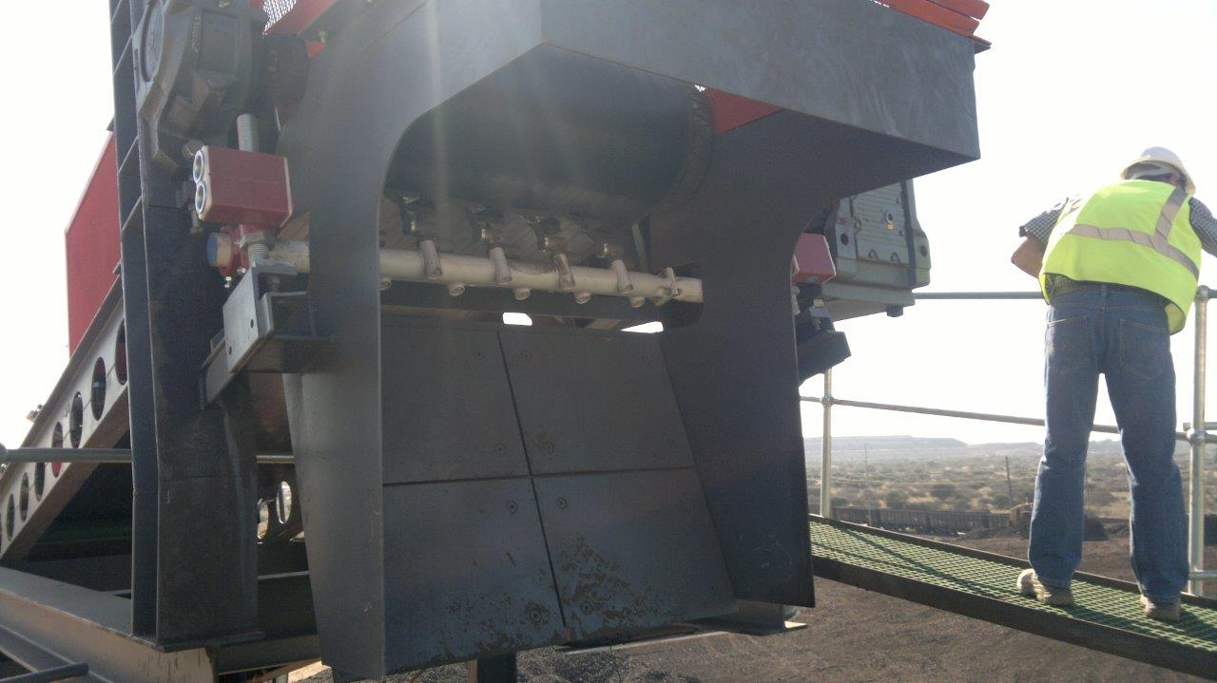
Head chute into the surge bin.
The Institute of Materials Handling

Slide 28
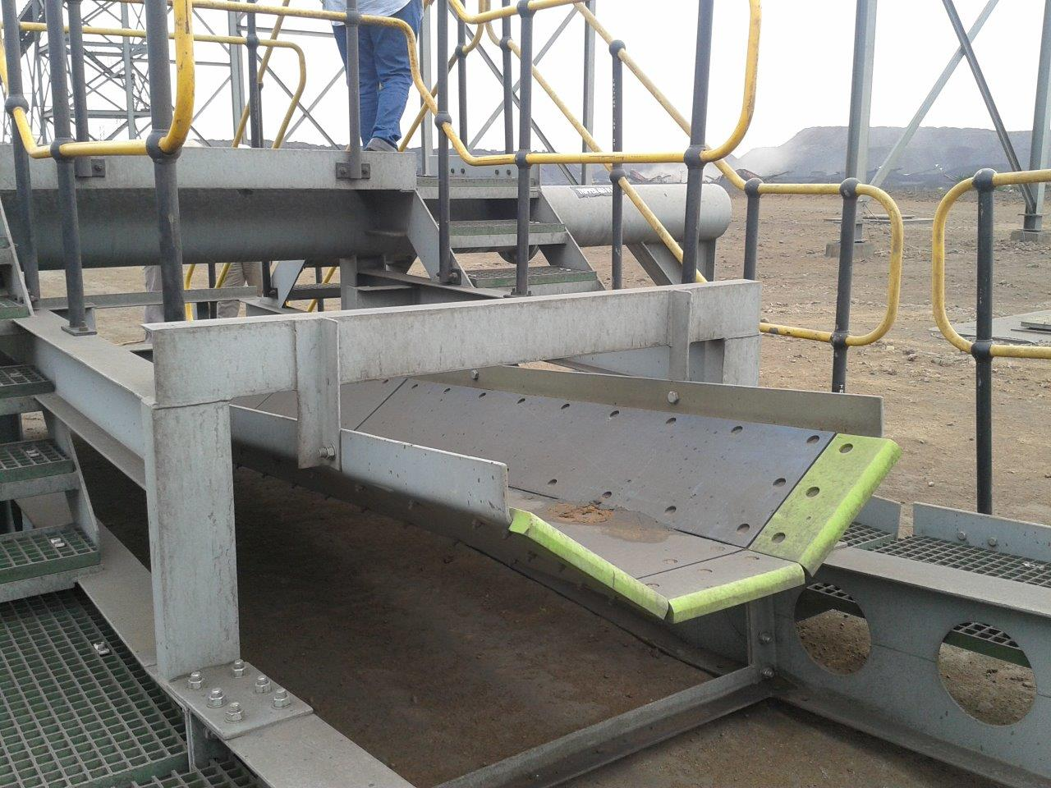
Chute and cross beam on a tripper.
The Institute of Materials Handling

Slide 29
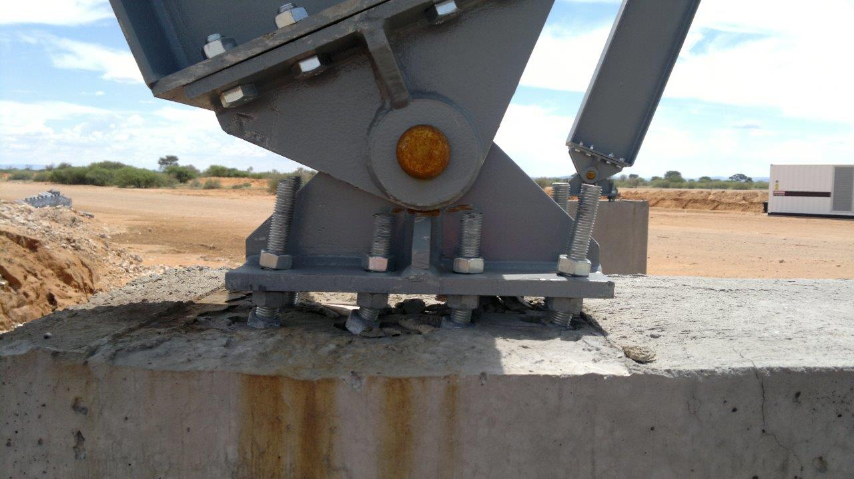
Bad construction.
The Institute of Materials Handling

Slide 30
Poor civil construction.
The Institute of Materials Handling

Slide 31
Concrete columns.
The Institute of Materials Handling

Slide 32
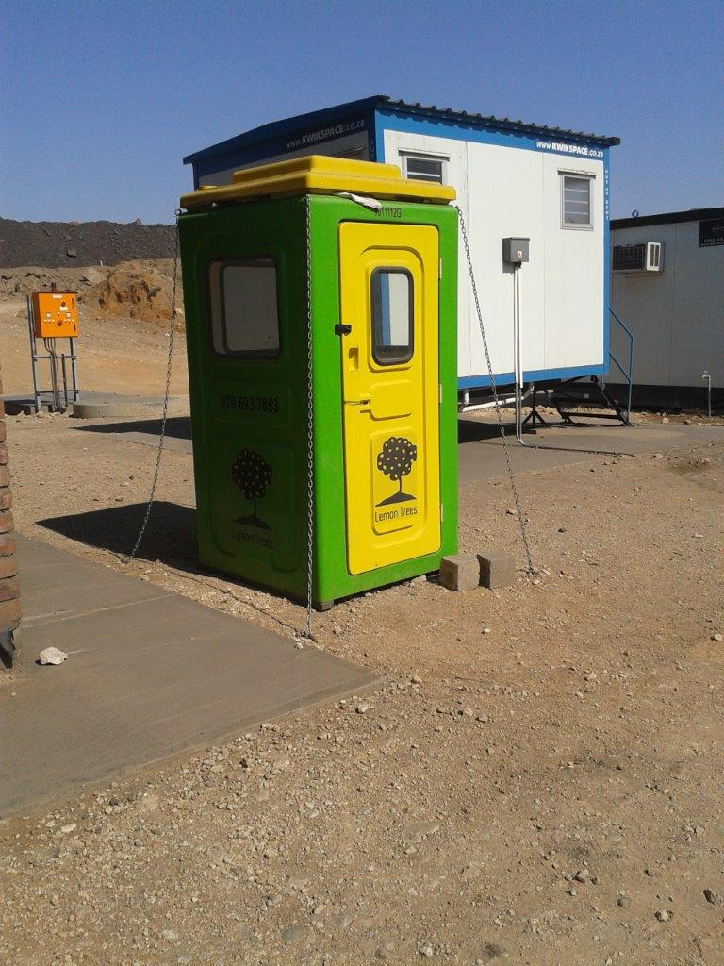
This was well secured !!!!
The Institute of Materials Handling

Slide 33
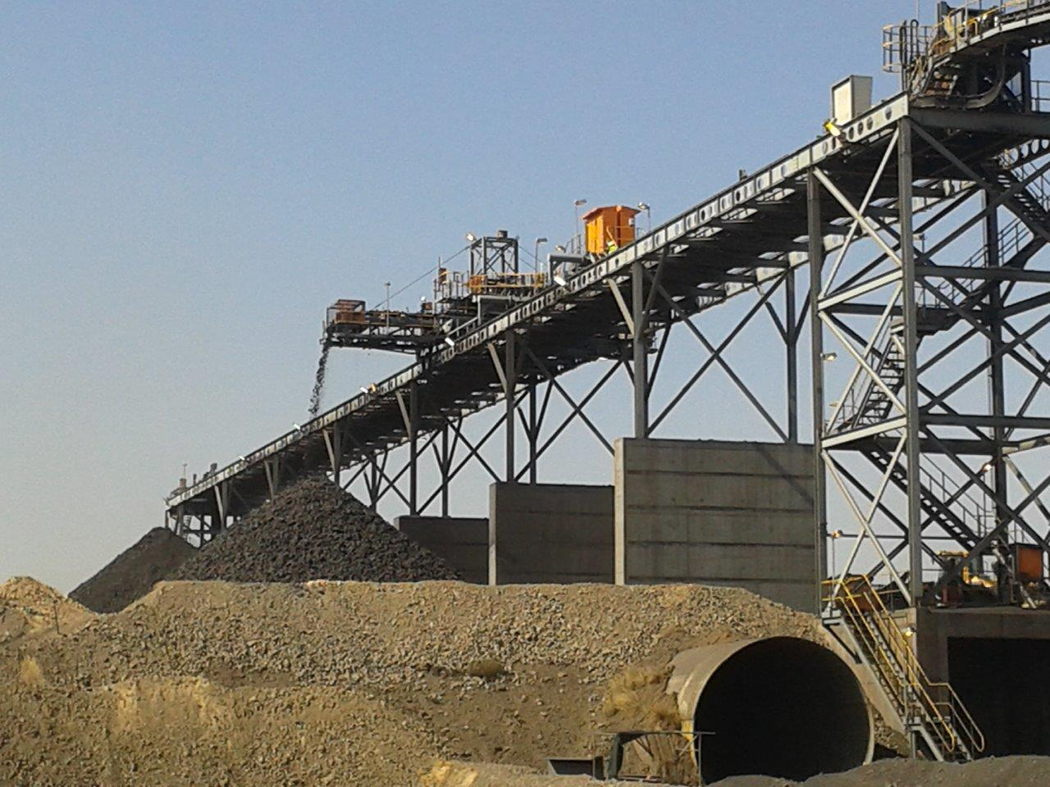
Plant in operation eventually.
The Institute of Materials Handling

