Slide 1
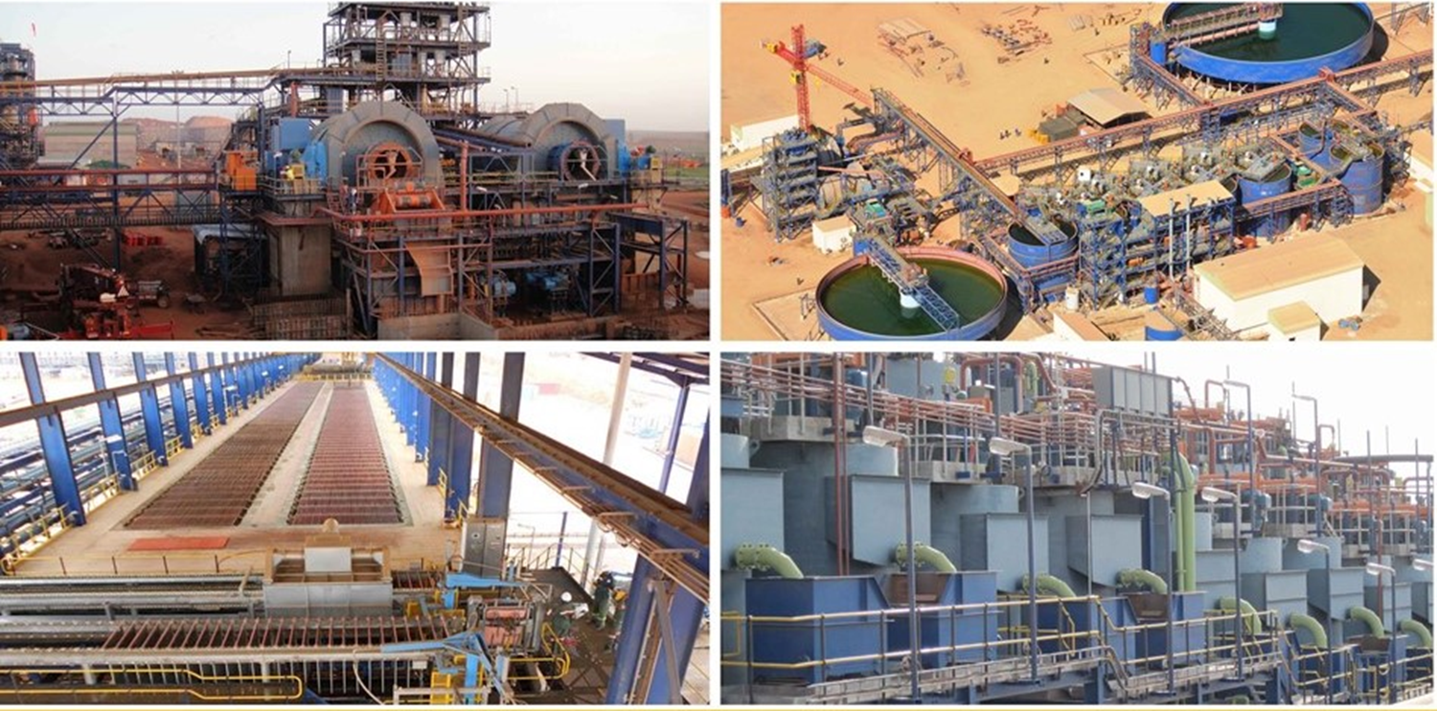

Slide 2
Horizontal Curved Conveyor belt training Procedure
Emirates Aluminium Smelter,
ALUMINA OFFSHORE CONVEYORS

Slide 3
HORIZONTAL CURVED CONVEYOR BELT TRAINING PROCEDURE
Introduction
The alignment of the horizontal curved conveyor belt is important in order to prevent the belt fouling with the structures, which will result in permanent damage to the belt and the affected structures. In addition, belt alignment is crucial to prevent product being spilled from the curved section of the conveyor along its length due to the banked idlers being in the incorrect position. The conveyor has been designed with idlers banked and positioned to suit precise operating belt tensions and conveyor profile. Slightly differences in the operating belt tensions, which are common over time, can be accommodated within the belt training procedure explained here-in. If belt tracking cannot be rectified using this procedure, an in-depth investigation needs to be conducted as to why operating belt tensions have changed significantly before banking angles are changed.
The correct alignment / training of the belt must be checked for operation under no-load, partial load and full load conditions. For the initial alignment check i.e. for the initial new belt and for subsequent replacement belts, the conveyor must be started only once all checks have been completed. The conveyor is then started without load, with suitable monitoring by personnel along the full length of the conveyor.

Slide 4
Training of the belt should preferably be performed by one individual only. This ensures that the there is no duplication of adjustment to the idlers, especially in this instance considering the length of this conveyor. In addition, a normal sequence of training is to start with the return run working toward the tail pulley and then follow with the top run in the direction of belt travel. Start with the belt empty. After tracking is completed, run the belt with a full load and recheck tracking. Tracking adjustment is done while the belt is running and should be spread over some length of the conveyor preceding the region of trouble. The adjustment may not be immediately apparent, so permit the belt to run for several minutes and at least two full belt revolutions (15 minutes) after each idler adjustment to determine if additional “tracking” is required.
Belt side travel
Belt side travel measurements are important to conveyors with horizontal curves. In horizontal curve areas, both the carry and return side idlers are banked towards the outside of the curve. As the conveyor is loaded, the belt tensions increase, which causes the belt to “pull” towards the inside of the horizontal curve. As the belt moves inwards, it is also forced upward by the banking angle of the idlers.

Slide 5
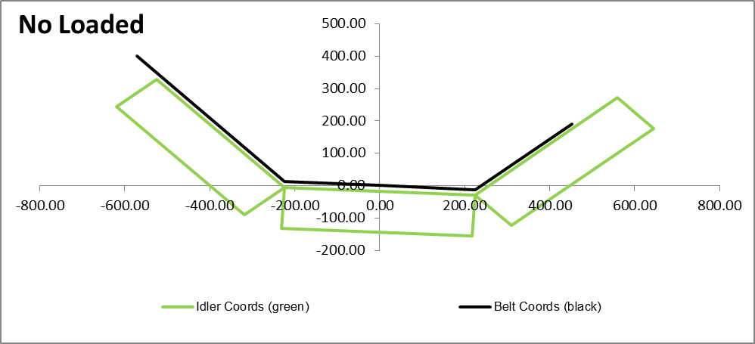
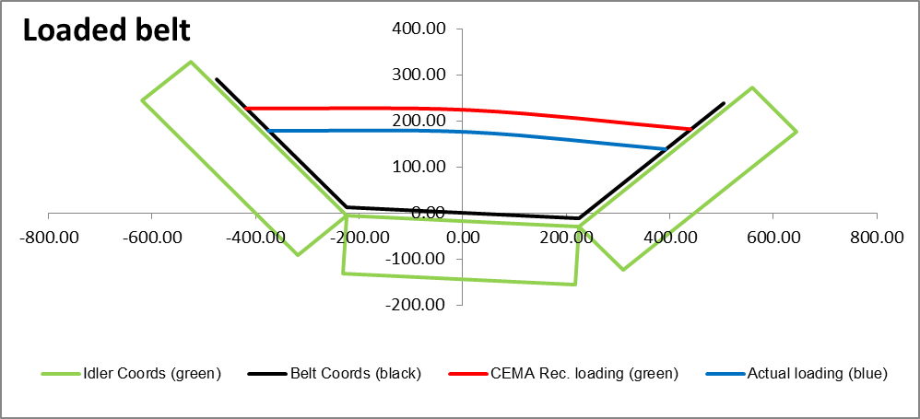
Gravity counteracts this movement and holds the belt in position. When the belt is empty, the tensions are generally lower and the belt moves to the outside position. Steady state and dynamic (starting/stopping) measurements are important in order to verify that the installed banking angles are adequate.
Figure 1 – Top side empty belt running Figure 2 – Top side fully loaded belt
running
Figure 1 above shows the that maximum drift to the inner curve occurs at maximum belt tension when the belt in the curve area is empty.

Slide 6
Training Procedure
To train the belt, the curved section is fitted with banked idler from 1 to 3 degrees, on the carrying and return strands respectively.
Entering the curved section the idlers are banked incrementally from 1 to 3 degrees to the middle of the curve and from the middle of the curve to the end of the curve the idlers are banked from 3 to 1 degrees.
To adjust the belt training, first establish whether the belt is mis-tracking during empty, partial and or fully loaded condition and find the source of the misalignment i.e. where the belt begins to misalign, and these idlers must be adjusted.
The bolts on the identified adjusting idler brackets must then be loosened slightly, to enable the bracket to be turned.
Loosen the idler frame securing fasteners on 2 or 3 adjacent idler sets commencing at the tail pulley, and knock one edge of the frames forwards / backwards in small increments, while the belt is moving (refer to sketch below). Similarly, adjust the return idlers to assist with the alignment of the belt working towards the tail pulley.

Slide 7
Correct Alignment
Incorrect Alignment
Corrective Action
Idler Alignment / Misalignment
Observe the effects which the adjusted idler frame location has on the position of the belt relative to the conveyor centreline. Once the belt has returned to the conveyor centreline, tighten the idler frame fasteners.
Care must be taken to prevent excessive adjustment of the banked idlers. Adjustments must be made in small increments, to three or four adjacent banked idlers at one time followed by observation for approximately 15 minutes (2 full cycles), to allow the adjustment to take effect before further adjustments are made.

Slide 8
Where idlers are adjusted, the conveyor section (stringer section) should be marked for reference purposes.
Once the belt is running true in the curved section, partial load should be conveyed, followed by full load testing. All banked idler brackets must be re-tightened once training of the belt is complete.
If it is found that by adjusting a series of banked idlers, the belt alignment is not improved, then the adjusted idlers must be re-set to their original positions before proceeding to the next series of conveyor section (stringer section) to make further adjustments. In this way the belt training procedure is conducted in a logical, systematic way.

Slide 9
Basic Rules of Conveyor Belt Tracking:
• The conveyor structure must be “True” (relative to the centre-line) and “Level” (side-to-side).
• All pulleys, snub rollers, carrying and return idlers must be “Square” with the frame (perpendicular to the belt centre-line) and parallel to each other.
• Cleanliness is essential to good conveyor belt tracking. No build-up of carry-back on the idlers or pulleys.
• Ensure the belt is stopped when making adjustments and remember that is better to make several small adjustments and be careful not over compensate.
• Start tracking and adjusting idlers on the return run, working toward the tail pulley.
• This is followed by adjusting the idlers on the top run in the direction of belt travel. Tracking a conveyor belt should never be done by adjusting pulleys. This can cause uneven conveyor belt stretch and or pulley and shafting problems.
• START WITH THE BELT EMPTY... and begin to add partial and full load.

Slide 10
• Tracking adjustments should be spread over some length of the conveyor preceding the area of trouble
• Load the material in the centre of the conveyor belt.
• If the belt runs to one side at a particular point or points along the conveyor structure the cause will probably be due to the alignment, or levelling of the structure or to the idlers and pulleys immediately preceding that particular area or combination of these factors.
• Fine tuning can be done by means of adjusting the banking of the idlers.
- End -

