Slide 1
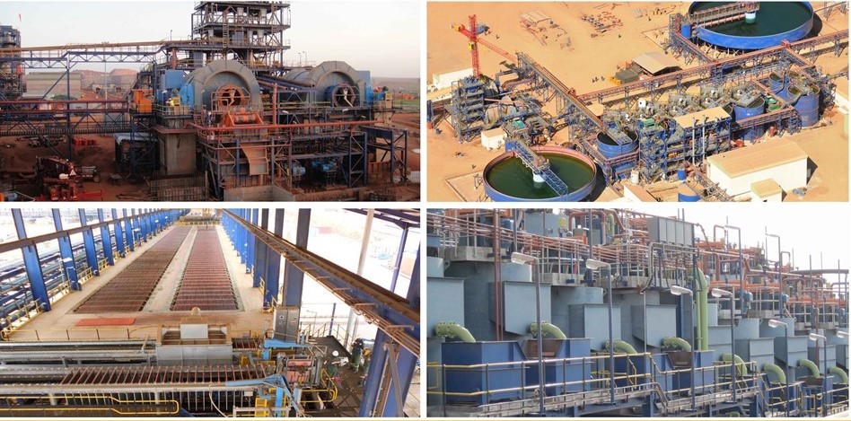
The Institute of Materials Handling

Slide 2
What is a Belt Conveyor
Emirates Aluminium Smelter,
ALUMINA OFFSHORE CONVEYORS

Slide 3
What is a belt conveyor?
1. Conveyor Functional Description 3
2. Conveyor Pulleys 4
3. Conveyor Idlers 4
4. Conveyor Belting 5
5. Electric Motors 6
6. Gearboxes 6
7. Fluid couplings / Flexible couplings (Variable speed drive) 6
8. Holdback Units 7
9. Skirtboards 7
10. Belt Cleaning 7
11. Conveyor take-up 8
12. “On-board” control & instrumentation 8

Slide 4
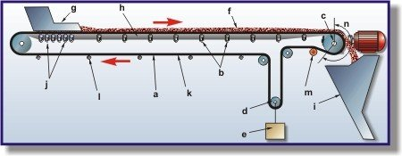
1. Conveyor Functional Description
A troughed belt conveyor comprises an endless, rubberized flat belt (a) suspended between pulleys at either end and supported along its length by a number of rotating idler rollers (b). The belt is driven via one of the pulleys (usually the head pulley (c)) and the tension in the belt is maintained by using a sliding pulley (d) which is tied to a gravity take-up unit (e).
The material (f) is loaded onto the conveyor at the tail-end via a chute (g) and is transported along the carrying-side (h) to the head-end where it discharges into a discharge chute (i) which guides the product onto the downstream equipment.

Slide 5
Impact idlers (j) are located at the loading point to support the belt where the load impacts onto the belt as it is dropped down the loading chute.
Once the material has been discharged from the carrying belt, the return belt (k) is guided back to the tail pulley on return idlers (l).
The impact, carrying and return idlers are spaced at different intervals. On the carrying-side, the mass of the belt plus the load conveyed is greater than the mass to be supported on the return-side and thus, for the tension in the conveyor belt (by the take-up and induced by the drive unit), the idler spacing is selected accordingly. This 'sag' in the belt between the carrying and return idler sets must therefore be designed on the basis of the heaviest load that the conveyor is to transport.
Snub pulleys (m) are sometimes incorporated into the design of a conveyor in order to increase the angle of wrap (n) of the belt on the drive pulley. The greater wrap angle on the pulley allows more power to be introduced into the belt as is passes around the drive pulley without slip occurring.

Slide 6
Belt conveyor functions
The belt conveyor rear end is known as tail-end. The material is fed onto belt conveyor near tail-end. The material so fed onto belt conveyor rests on upper run of the belt and travels forward with the belt. The material on reaching head pulley drops down automatically due to gravity and discharge velocity, while turning around the head pulley. The belt conveyor forward end is known as head-end. Thus material is conveyed from tail-end to head-end in continuous manner.
The point where material is put on belt is known as feed-point / loading point. The conveyor can also have more than one feed point or moving feed point.
The point where the material is getting discharged from belt is known as discharge-point. Generally this is head-end of conveyor, but it can also be created at intermediate point by specialized means.
It is to be specifically noted that belt conveyor simply conveys / transports whatever quantity of material is put on belt at feed point, without any control on quantity to be conveyed.

Slide 7
If the incoming material quantity is less, it operates at partial load. If the incoming material quantity is excessive, it will lead to spillage and even breakdown. Therefore, it is important that the quantity being fed to conveyor should not exceed the design.
2. Conveyor Pulleys
Pulleys are necessary in a conveyor to change the direction of belt in vertical plane, and form endless loop for continuous operation. In addition, the drive pulley also transmits the power to the belt. The pulleys can be broadly categorized as drive-pulley and non-drive pulley. The drive pulley supports the belt at bend, and also transmits power to belt. The non-drive pulley only supports the belt at bend.
3. Conveyor Idlers
The fact that idlers come into direct contact with a conveyors' belting extremely frequently, combined with the fact that belting is usually the highest cost item on a conveyor, means that idlers should cause the least possible wear or damage to the belting as possible.

Slide 8
Idler functions
• To support belt along with material on carrying run, with minimum resistance to be tension.
• To support belt on return run, with minimum resistance to belt motion.
• To form the belt trough profile for accommodating material on carrying run.
• To provide special support to belt at loading for proper positioning of material on belt, with minimum wear and tear to belt.
• The carrying belt changes its shape from flat to trough at tail pulley, and trough to flat at head pulley. The transition idlers gradually change the belt profile at these locations, with minimum strain to belt.
• The idlers are required to improve alignment of the belt i.e. idlers should automatically try to bring the belt centre line close to conveyor centre line.

Slide 9
4. Conveyor Belting
The fundamental purpose of a conveyors' belt is to carry the loaded material along the length of the conveyor structure, from the feed point at the tail of the conveyor, to the discharge point at the head of the conveyor.
Belt is an important component in design of belt conveyor, because:-
• It is the belt, which is actually conveying material.
• Belt is in contact with material and is taking all the punishment from material, such as impact & abrasion.
• Often, belt is the costliest item, effecting capital investment.
• Belt is a wearing item. Improper maintenance can result into fast wear and tear of belt, resulting into high running cost.
There are two basic categories into which all troughed conveyor belting falls namely, Fabric Belting and Steel Cord Belting.
Externally both types of belt appear to be identical, however, the difference is in the internal structure of the belt.

Slide 10
The internal structure or carcass of a belt dictates the tensile strength of the belt. In fabric belts the carcass comprises 'plies' or mats of reinforced fabric separated by cushioning layers. Steel cord belts on the other hand have a series of steel cables embedded into the belt, separated by rubber. When tension is applied to the belt, the carcass absorbs the force. The greater the required tensile force to move the transported material, the greater is the required strength of the belts' carcass.
In both fabric and steel cord belts, the carcass is covered by rubberized covers to protect the carcass or cables.
Electric Motors
Electric motors are usually the prime movers in any conveyor system. Whenever electric power is available, the most practical method of driving the belt conveyor is to make use of an electric motor. For practical reasons industry has standardised on a range of the motor frame sizes, power ratings and electrical power supplies to these motors.

Slide 11
6. Gearboxes
A simple definition of the purpose of a gearbox may be stated as: A Gearbox is a unit which receives the primary input speed - driving speed source and alters it to a different output speed - driven speed source using a series of gears. Thus the fundamental purpose of a gearbox is to transmit uniform motion between two shafts at a constant ratio.
Fluid couplings / Flexible couplings (Variable speed drive)
Fluid couplings are an integral component in a belt conveyors' drive assembly and are installed between the drive motor and the reducer unit. Bulk material handling conveyors are becoming faster, wider and larger, necessitating increased power to meet today's demand for higher productivity. The ability of the drive system to start the conveyor slowly and smoothly is crucial to a company's bottom line. If starting torques are too high, the risk is increased for equipment damage, spillage, downtime and unnecessary expense.

Slide 12
Importance of Soft Start
The starting of AC motor systems can produce excessive belt tension and rapid acceleration rates. In fact, AC motors often exceed 250% of full load torque during start-up. Also, the motor current can remain at up to 600% of full load during acceleration. Ultimately, high current builds up heat that can drastically shorten the motor's life expectancy. With empty or partially loaded belts, the acceleration rate will be even faster and the excessive high-torque shock loads during start-up can eventually surpass the belt's design limits. Belts can be damaged, splices can break and take-up problems may occur, not to mention the high potential of material spillage.
In either case, with belts empty or full, the threat remains for lost profits associated with downtime and belt breakage costs. Fluid couplings offer a 'soft start' option specifically for conveyor drive systems to prevent such damage and loss.
Under both loaded and unloaded starting conditions, fluid couplings are designed to provide smooth conveyor acceleration by keeping initial starting torque as low as 40% of full load, controlling acceleration, and dampening shock and vibration.

Slide 13
8. Holdback Units
Where belt conveyors are employed to elevate the transported material through a relatively steep incline and / or where the inclination of the conveyor could lead to the belt running in reverse when de-energised, a holdback unit or backstop is incorporated into the design of the conveyor.
Holdback units are either installed on the head or drive pulleys' shaft opposite to the drive assembly or alternatively, holdback units can be incorporated into the reducer and supplied as an integral unit with the drive unit.

Slide 14
9. Skirtboards
To retain the material on the belt-after it leaves the loading chute and until it reaches belt speed-skirtboards are necessary. These skirtboards usually are an extension of the sides of the loading chute and extend parallel to one another for some distance along the conveyor belt. The skirtboards normally are made of metal, although wood sometimes is used. The lower edges of the skirtboards are positioned some distance above the belt. The gap between the skirtboard bottom edge and the belt surface is sealed by a rectangular rubber strip, attached or clamped to the exterior of the skirtboard.
10. Belt Cleaning
Belt conveyor needs belt cleaners at two locations. One location is immediately after discharge pulley, and the other location is just before tail pulley.

Slide 15
Scrapers & Ploughs
Scrapers
These are normally mounted adjacent to the head pulley, care should be taken that the scrapers are held against the belt surface with only sufficient pressure to remove the materials, without causing damage to the belt. With sticky materials, it is usually necessary to apply a scraper to the snub pulley.
Ploughs
Ploughs should be placed immediately in front of the tail pulley or other pulleys on return run, to prevent material falling on return run from being carried between the belt and pulley. Ploughs set at an angle of approximately 45o with the direction of belt travel, are usually held against the belt by gravity.

Slide 16
11. Conveyor take-up
11. Conveyor take-up
Belt conveyor includes take-up device to maintain proper tension in belt. The ‘proper’ tension implies ‘minimum’ tension to fulfil all the functional needs such as:-
Adequate tension to transmit mechanical power from drive pulley/s to belt in all operating conditions.
Adequate tension to limit sag of belt between idlers, in all operating condition.
If the tension is more than the necessary, it will result in costlier belt, pulleys and terminal structures.

Slide 17
12. “On-board” control & instrumentation
“On-board” control & instrumentation
The “On-board” control & instrumentation refers to the control & safety electronic instruments that are installed on the conveyors, to ensure that the conveyor operates safely within design parameters, and that conveyor can be stopped in an emergency. These instruments are:
• Pull cord emergency stops
• Belt tear switches
• Belt alignment switches
• Belt slip & motion detectors
• Blocked chute detectors
• Take-up “Over travel” switches

